Slide 1
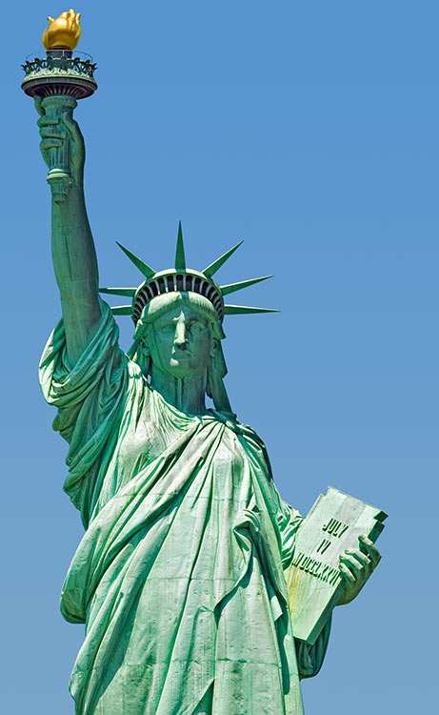
New Immigrants

Slide 2
New Wave of Immigrants
Millions of immigrants come in search of opportunities in late 1800’s
1800 to 1880 more than 10 million immigrants came to United States
1891 to 1910 12 million immigrants arrive in US
Come to escape persecution and poverty

Slide 3
The Journey
Immigrants learned of opportunities from steamship and railroad company promoters
  Companies lie about opportunities
Most immigrants traveled in steerage
  Poorest accommodations possible
Traveled in lower levels of ships next to steering mechanisms
  Quarters cramped with little ventilation

Slide 4
Arriving in America
Late 1800’s arrived at two major areas
  Ellis Island, New York; Angel Island, San Francisco
Ellis Island opened in 1892
First thing immigrants saw on way in was Statue of Liberty, was a symbol of hope
All newcomers through Ellis Island had to go through a physical exam
If had a bad disease like TB you were deported

Slide 5
Arriving in America
Those who passed physicals entered an endless maze of people
They were questioned about background, job skills, and relatives
If you had criminal record you were sent back
On Angel Island you had thousands of Asian immigrants
Entrance limited to certain skill groups

Slide 6
A New Life
Most immigrants settled in crowded, poor housing located in heavily populated cities
Found only low-paying, unskilled jobs
Many industrial cities had many ethnic neighborhoods
Neighborhoods also had many different religious institutions

Slide 7
A New Life
Residents in many cities formed benevolent societies
  These Societies provided help for all kinds of problems
  Ex: unemployment, death, sickness, loans
Immigrants were urged by public institutions, employers, and family to assimilate into American Society
Many children did, however, many adults held fast to their old traditions

Slide 8
A New Life
Per. 5
Most immigrants did the “dirty work” of the United States
Worked in sweat shops, construction, and mines
Hours were long and exhausting and pay was very little
Many worked 15 hours a day and still struggled to make a living
Why did workers put up with this?

Slide 9
Nativist Response
Many native born Americans saw immigration as a threat
Started blaming immigrants for all country’s problems like crime, poverty, and violence
As unemployment in west started to climb many called for the removal of the Asian population
1882 Congress passed Chinese Exclusion Act which denied citizenship to those born in China.

Slide 10
Nativist Response
Act made conditions worse for the Chinese
Anti-immigration groups formed
Immigration Restriction League called for a literacy test for all immigrants
President Grover Cleveland vetoed it saying it was “illiberal, narrow, and un-American”
Despite opposition people continued to immigrate

